Slide 1
CONTENT RECOMMENDATION SYSTEM FOR F13 TECHNOLOGIES
Submitted By:
Tushar Sehdev
Museib Patel
Mohd Abdul Ghani
Dhatchana Moorthy Mathan
Submitted To:
Tarleen Kaur,
F13 Technologies

Slide 2
Contents
1. Introduction
2. Content Recommendation System
3. Architecture Diagram
4. Cost Analysis
5. Performance Analysis
6. Case Study: SKY (Entertainment platform)
7. Conclusion
8. Reference

Slide 3
Introduction
Content recommendation system is a useful tool that can improve user experience, engagement, and conversion by offering personalized and relevant suggestions based on user preferences and behavior. Content recommendation system can be applied to various types of content, such as products, articles, videos, and more, across different industries, such as e- commerce, media, and entertainment. Content recommendation system can help businesses differentiate themselves from competitors, increase customer loyalty, and maximize revenue.
AWS Personalize is a fully managed machine learning service that allows developers to easily build and deploy custom content recommendation system without any prior machine learning knowledge. AWS Personalize uses advanced algorithms, such as collaborative filtering and personalized ranking, to analyse user data and generate recommendations for different use cases, such as similar items, user segmentation, and unstructured text. AWS Personalize also supports real-time updates and A/B testing to improve the recommendation quality and user satisfaction. In an era where data is abundant and user expectations are ever-evolving, the CRS is poised to be a game-changer, ushering in a new era of tailored, user-centric service recommendations. This report serves as a roadmap to navigate the depths of this innovative recommendation system, ultimately unlocking its potential to transform the way we interact with digital
services.

Slide 4
CONTENT RECOMMENDATION Data Processing: • During the data processing phase, information from the Movie Lens dataset is extracted and structured into three separate files: links, movies, and ratings. • The links file typically serves as a repository for linking movie IDs to external databases or sources ,aiding in cross-referencing and obtaining additional contextual information. • The movies file contains metadata for each movie, encompassing details like title, genre, and release year ,essential for content identification and classification. • The ratings file contains user-generated ratings for specific movies, reflecting user preferences and engagements with the content. This organized data framework facilitates streamlined analysis and modeling, supporting tasks such as developing recommendation systems and comprehending user behavior effectively.

Slide 5
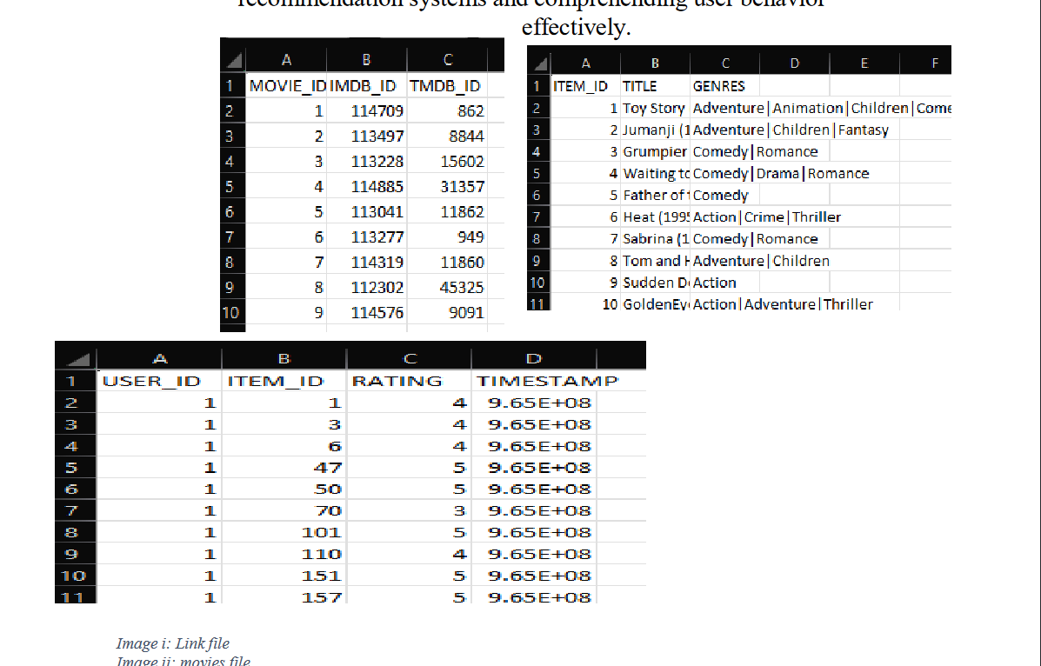

Slide 6
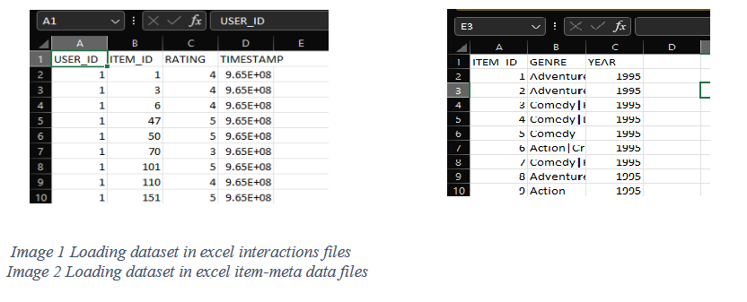
Data Pre-Processing: The first step in building the CRS was to collect and prepare the data. A sample dataset was created, containing files item-meta data & interactions where data of USER_ID, ITEM_ID, TIMESTAMP, EVENT_TYPE are filled. This data is pre processed from the movies lens data files using python. So it can be suitable for deployment and import files.

Slide 7
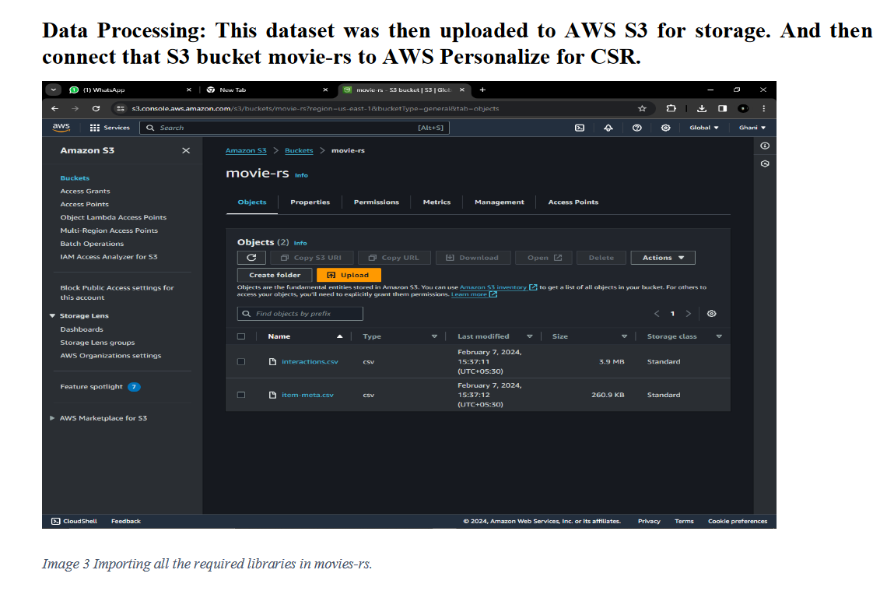

Slide 8
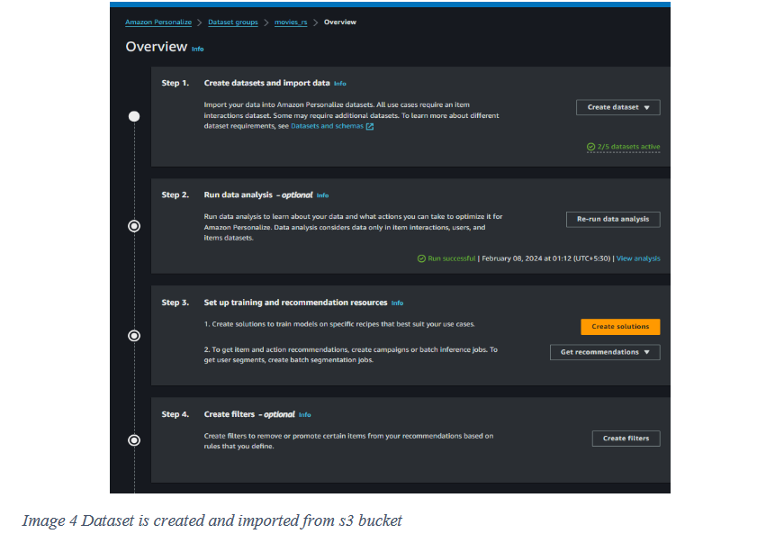
Aws Personalize:
Now we create a Data set in AWS Personalize, here first step we create a Dataset
group with name “movies_rs” in which we import the dataset in .csv format from
s3 bucket of movies-rs.

Slide 9
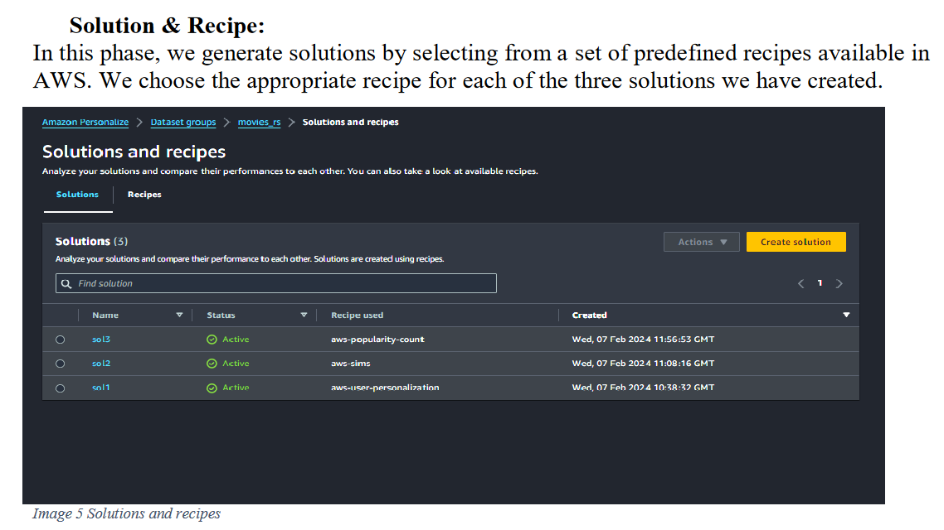

Slide 10
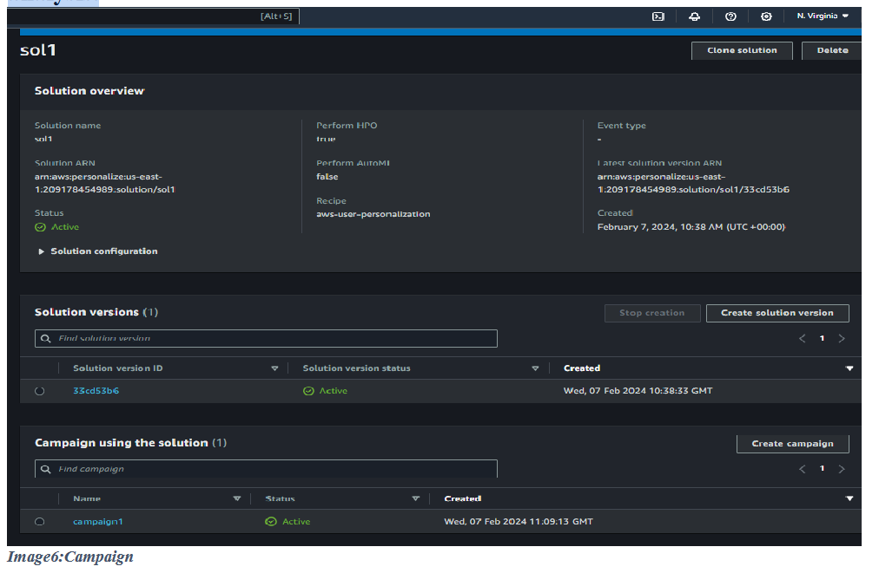
Runing Campaign:
In this phase we create a campaign to the solution, configure settings such as campaign budget, duration, target audience, geographic targeting, etc., depending on your campaign requirements. Start the campaign by deploying your resources and activating your advertising or promotional content. Make necessary adjustments to your campaign settings or resources to optimize performance based on real-time data analysis.

Slide 11
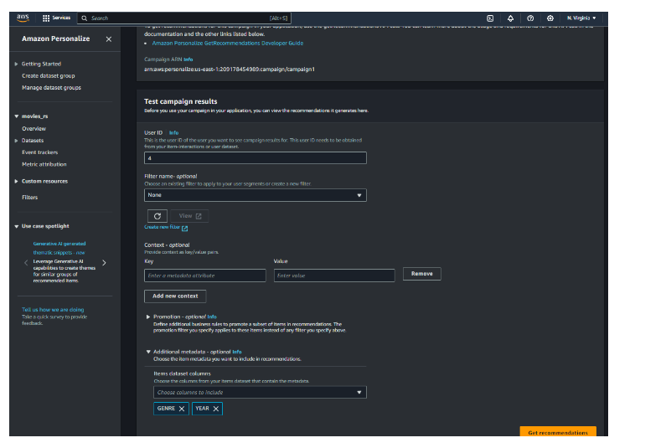

Slide 12
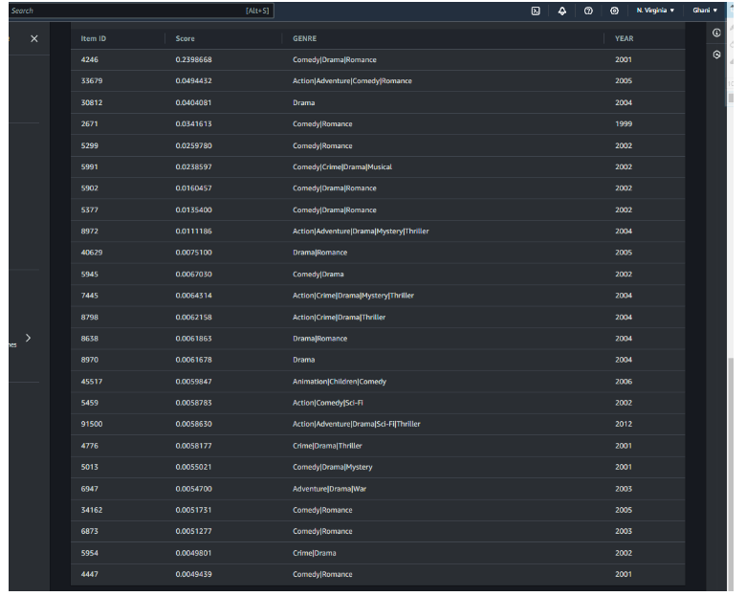

Slide 13
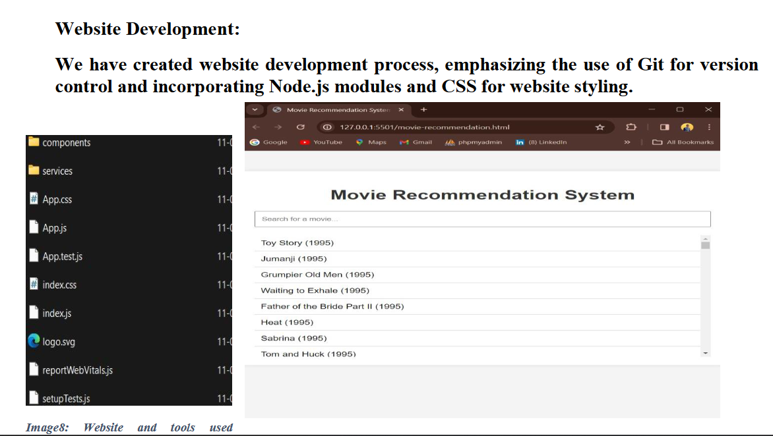

Slide 14
Preference and Behavior:
User preferences and behavior are captured implicitly through the system's
interactions. When a user selects or engages with a service, the CRS can record
this behavior and use it to refine recommendations. However, this report does not
cover the explicit mechanisms for collecting user data.
The camp1: Precision At 5 0.0679 At 10 0.0482 At 25 0.0314
The camp2: Precision At 5 0.0676 At 10 0.0426 At 25 0.0259
The camp3: Precision At 5 0.0116 At 10 0.0116 At 25 0.0099
In this we see precision speed of camp1 is high so we are using solution1 for our
website.

Slide 15
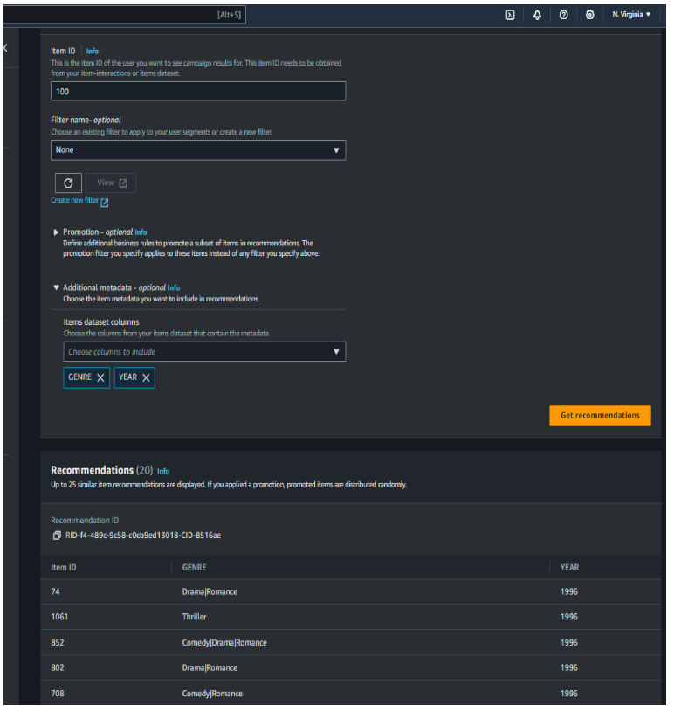

Slide 16
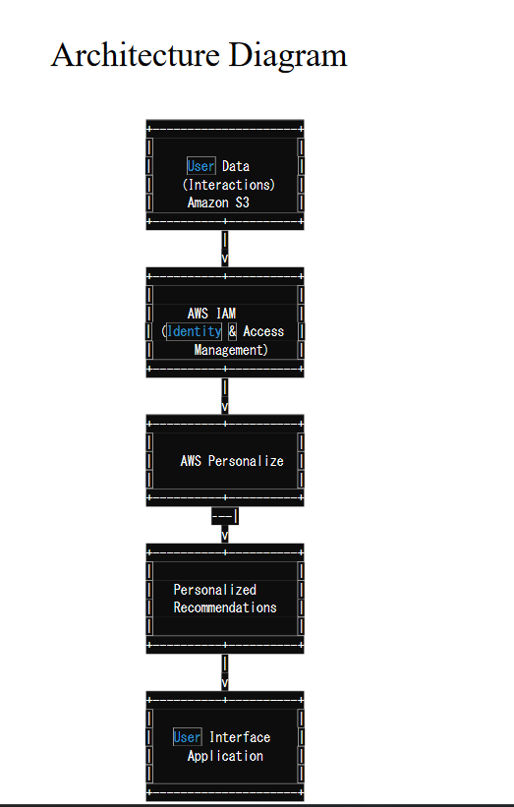

Slide 17
Aws services Used
Amazon S3 (Simple Storage Service):
Amazon S3 is an object storage service provided by Amazon Web Services (AWS). It is designed to store and retrieve vast amounts of data securely and cost- effectively. S3 offers scalable, durable, and highly available storage, making it a popular choice for storing various types of data, including files, images, videos, and datasets.
Key Features of Amazon S3:
Object-Based Storage: S3 stores data as objects, each consisting of data, a unique key, and metadata.
Scalability: It scales seamlessly to accommodate any volume of data, from gigabytes to petabytes.
Durability: S3 redundantly stores data across multiple data centers, ensuring 99.999999999% durability.
Security: S3 provides access control mechanisms and supports encryption to protect data.
Data Lifecycle Management: You can automate data retention and deletion
policies.
Data Versioning: S3 allows versioning of objects, enabling data recovery in case
of accidental deletions or overwrites

Slide 18
Amazon EC2 (Elastic Compute Cloud):
Amazon EC2 is a core AWS service that provides resizable compute capacity in
the cloud. It allows you to create and manage virtual servers known as EC2
instances. Here are key points about EC2:
a) Elasticity: EC2 instances can be easily scaled up or down to accommodate
changing workloads, making them suitable for hosting applications of all
sizes.
b) Customization: Users have full control over the operating system, software,
and configurations of EC2 instances, allowing for highly customized hosting
environments.
c) Security: Security features like security groups, network ACLs, and IAM
(Identity and Access Management) allow users to secure their instances and
applications.

Slide 19
IAM User (Identity and Access Management User):
An IAM User is a persona within AWS Identity and Access Management (IAM) that
represents an individual entity or application requiring access to AWS resources.
a) Access Control: IAM Users are assigned permissions to access specific AWS resources,
allowing fine-grained control over actions they can perform.
b) Multi-Factor Authentication (MFA): IAM supports MFA, adding an extra layer of
security by requiring additional verification beyond just a username and password.
c)Access Keys: IAM Users can generate access keys for programmatic access to AWS
services via APIs, enhancing automation capabilities.

Slide 20
Amazon CloudWatch:
Amazon CloudWatch in a personalized recommendation system implemented using AWS
Personalize, operators can effectively monitor, troubleshoot, and optimize the system's
performance and reliability, ensuring a seamless and personalized user experience.

Slide 21
In-Depth Analysis of SKY Content
Recommendation System
Introduction:
Content Recommendation Systems (CRS) have become an integral part of many
online platforms, aiding users in discovering relevant content in the vast sea of
options. In this report, we will delve into the workings of an existing CRS by
examining Sky’s recommendation system. We will analyze its features,
architecture, algorithms employed, and overall effectiveness.
Sky’s recommendation system overview:
Sky, a European media and telecommunications company, employs a sophisticated
recommendation system powered by AWS Personalize to enhance user engagement and
satisfaction across its platforms.
a. Personalization: Sky's content recommendation system tailors’ suggestions for individual
users by analyzing their viewing history, preferences, and interactions across the platform.
b. Diverse Recommendation Types: Sky provides recommendations spanning various
content categories such as TV shows, movies, documentaries, and sports events, catering to a broad audience.

Slide 22
c. Discovery and Surprise: The system balances familiar suggestions with unexpected
content choices, encouraging users to explore new shows and genres.
d. Individual Profiles: Sky allows multiple user profiles within a single account, with each
profile receiving personalized recommendations based on its unique viewing patterns.

Slide 23
Architecture:
a) Sky's content recommendation system architecture likely involves multiple
components:
b) Data Ingestion: Integration with various data sources such as user interaction data,
content metadata, and contextual information.
c)Data Processing: Pre-processing of raw data to extract features, transform data into
suitable formats, and perform data cleaning tasks.
d)Model Training: Utilization of AWS Personalizes machine learning algorithms to
train recommendation models based on historical user behavior and content attributes.
e)Model Deployment: Deployment of trained models to generate real-time
recommendations for users across Sky's platforms.
f)Feedback Loop: Integration of user feedback mechanisms to continuously update and
refine recommendation mod

Slide 24
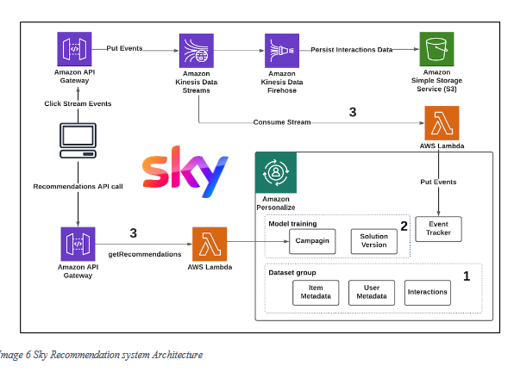

Slide 25
Algorithms Employed:
Sky's CRS utilizes several recommendation algorithms, including:
a. Sky likely employs a variety of machine learning algorithms provided by AWS
Personalize, such as:
b. Collaborative Filtering: Analyzing user interactions and similarities to
recommend content based on similar user preferences.
c. User Personalization: Building personalized recommendation models tailored to
individual user preferences and behavior.
d. Item-to-Item Recommendations: Recommending similar items based on content
attributes and user preferences.
e. These algorithms are trained using historical data and optimized to provide
accurate and relevant recommendations to Sky's users.
f. Contextual Bandits: To consider temporal and situational context in
recommendations

Slide 26
Overall Effectiveness:
Sky's recommendation system is highly effective and plays a pivotal role in
retaining subscribers. It is estimated that over 80% of the content watched on
Sky’s is driven by recommendations. The system's success can be attributed to its
ability to:
a. Understand User Behavior: Sky comprehensively analyzes user behavior,
including viewing history, time of day, and device used.
b. Adapt in Real-Time: Recommendations are updated frequently to reflect user
interactions, leading to continuous improvement.
c. Balance Exploration and Exploitation: The system encourages users to explore
new content while also catering to their known preferences.
d. Handle Cold Start Problem: Sky effectively addresses the "cold start"
problem for new users by leveraging content-based recommendations initially.

Slide 27
Conclusion:
Sky's content recommendation system serves as an exemplary case study of a
hybrid recommendation system's capabilities. Its personalized, real-time, and
adaptable nature makes it a powerful tool for content discovery, contributing
significantly to user satisfaction and platform success. The combination of
collaborative filtering, content-based filtering, and machine learning algorithms
forms the backbone of this highly effective system, providing valuable insights
for the field of recommendation systems

